Slide 1


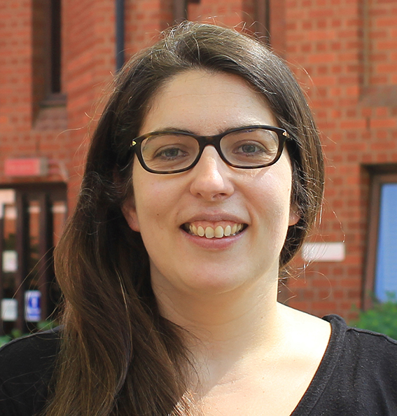
Talk
Lúcia GARRIDO
City St George’s, University of London
Thursday June, 5th at 3:30PM
Auditorium Pasteur 2 - LEW
"Recognizing people’s faces: from prosopagnosia to brain representations"
Contact: olivier.collignon@uclouvain.be
http://www.uclouvain.be/ions.html
Notes:
1

