Slide 1




BZRA use and cessation in multimorbid polymedicated hospitalised older adults: analysis from the OPERAM trial
François-Xavier Sibille, Séverine Henrard, Carole Elodie Aubert, Namiko Goto, Emma Jennings, de Saint-Hubert Marie, Olivia Dalleur, Nicolas Rodondi, Wilma Knol, Denis O’Mahony, Matthias Schwenkglenks, Anne Spinewine
1st International Conference On Deprescribing
07.09.2022

Slide 2
Conflict of interest
FX Sibille: Clinical Master Specialist Applicant for a Ph.D. of the Fonds de la Recherche Scientifique – FNRS (Belgium)
This work is part of the project “OPERAM: OPtimising thERapy to prevent Avoidable hospital admissions in the Multimorbid elderly” supported by the European Union's Horizon 2020 research and innovation programme under the grant agreement No 6342388, and by the Swiss State Secretariat for Education, Research and Innovation (SERI) under contract number 15.0137. The opinions expressed and arguments employed herein are those of the authors and do not necessarily reflect the official views of the EC and the Swiss government.”

Slide 3
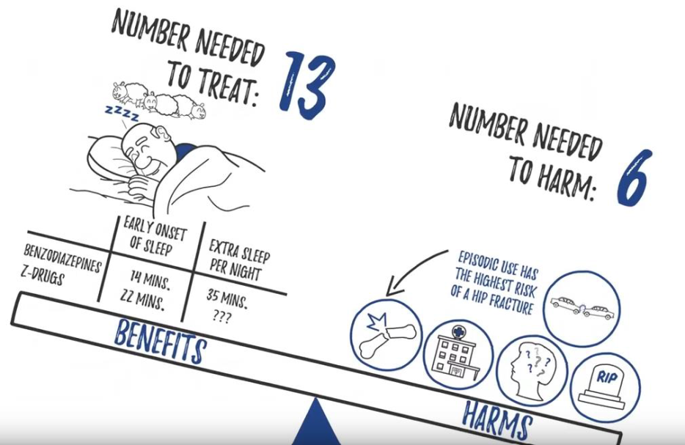
Background
BZRA
The OPERAM study
Benzodiazepines + Z-drugs
Inappropriate but frequent
Cluster RCT
4 hospitals in 4 European countries
Multimorbid, polymedicated older adults
Pharmacotherapy optimisation intervention
STOPP D5: benzodiazepine for ≥ 4 weeks
Canadian Deprescribing Network
Adam BMJ Open 2019; Blum BMJ 2021
Notes:
BZRA use for a period of > 4 weeks was one of the triggers of the clinical decision support system based on the STOPP criteria

Slide 4
Objectives
Methods
BZRA use before hospitalisation
BZRA cessation 6 months after hospitalisation
Factors associated with BZRA cessation
Multivariable logistic regression:
General information
Comorbidities
Addictions
Anxiety/depression levels
Intervention arm
Medications
EQ-5D Health Questionnaire Dolan, 1997
Notes:
Our primary objective was to measure the rate of BZRA cessation 6 months after hospital admission, and to identify factors associated with cessation.
A secondary objective was to describe BZRA use on admission and identify associated factors.

Slide 5
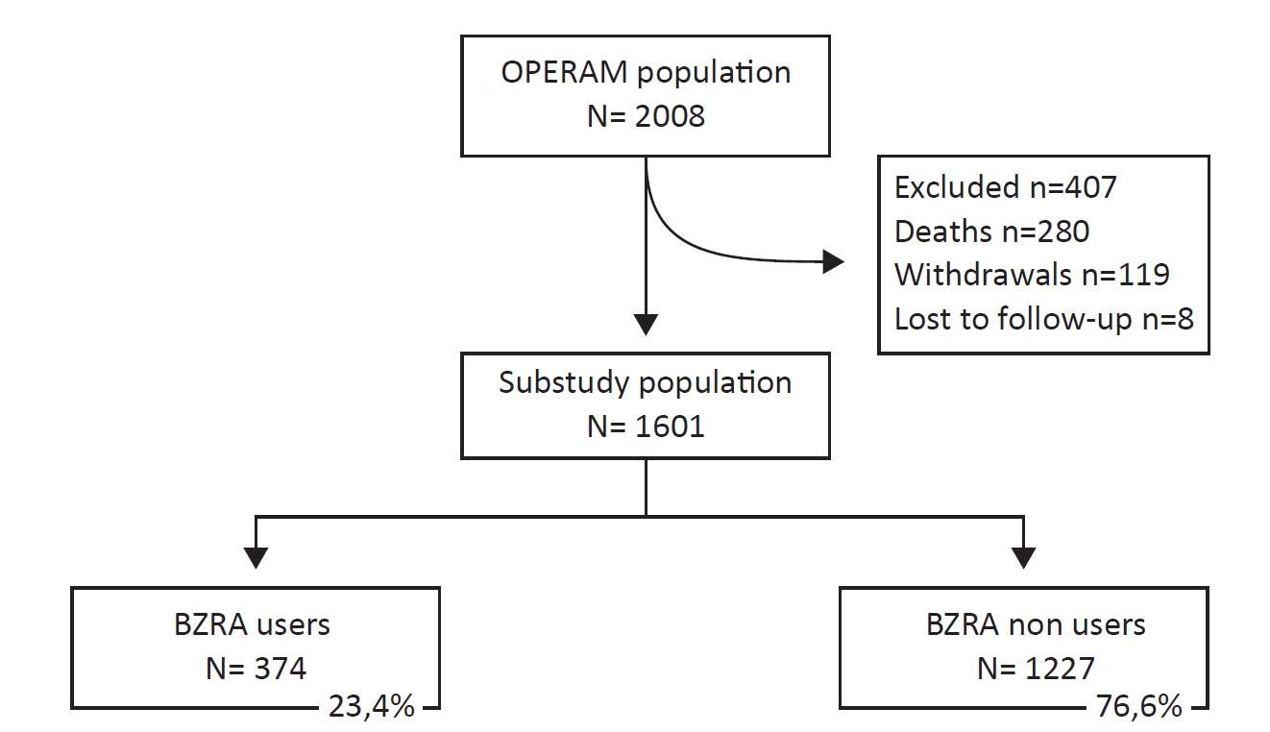
Flowchart

Slide 6


Population description
Median age 78 years [74; 83]
45% women
Fall(s) 12 months 39%
Median length of stay 6 days
Median 10 drugs [7;12]
Antidepressant 24%
Opioid 15%
Antiepileptic 14%
Antipsychotic 5%
Notes:
To answer our first research question: what proportion of participants were BZRA users at baseline, meaning before hospitalisation

Slide 7
Flowchart
Notes:
I let you a few seconds to guess what proportion of BZRA users at baseline had discontinued their BZRA after 6 months

Slide 8
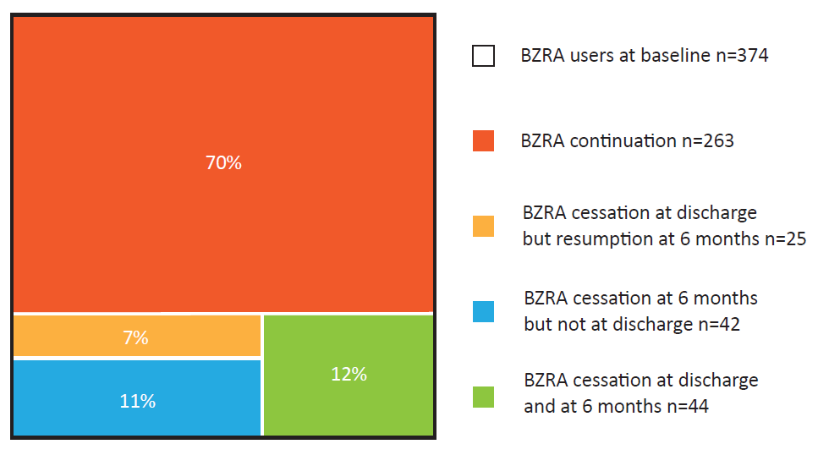
BZRA cessation
N=86 (23.0%)
Notes:
Among the 374 users at baseline, 86 had BZRA cessation at 6 months follow-up, this correspond to 23% of BZRA users at baseline.

Slide 9
Factors associated with BZRA cessation
Antidepressant use: OR [95%CI] 1.7 [1.1; 2.9]
Previous fall: OR [95%CI] 1.8 [1.1; 2.8]
Intervention arm: OR [95%CI] 1.5 [1.0; 2.3]
COPD: OR [95%CI] 0.5 [0.2; 0,9]

Slide 10
Discussion
BZRA cessation higher with antidepressant use
BZRA cessation higher when fall in the past 12 months
Recruitement sites
Significant differences regarding BZRA use at baseline
Huerta et al Pharmacoepidemiol Drug Saf 2016, OECD 2019
No difference regarding BZRA cessation
Sibille BMC G 2022, Baandrup Cochrane Database of SR 2018
Scott Int J Clin Pharm 2018

Slide 11
Thank you for your attention Questions ?
francois-xavier.sibille@chuuclnamur.uclouvain.be

Slide 12
Backup slides

Slide 13
Sub study population characteristics

Slide 14
 | Total N=1601 (100%)
General information
Median age [Q1; Q3] | 78 [74;83]
Male sex (%) | 887 (55.4)
Functional status: Median Katz score [Q1; Q3] Not-independently living$ (%) | 5 [4;6] 276 (17.3)
Median length of stay [Q1; Q3] | 6 [3-10]
Non elective admission (%) | 1208 (75.5)
Recruitment site, n (%) Bern (Switzerland) Louvain (Belgium) Utrecht (the Netherlands) Cork (Ireland) | 696 (43.5) 305 (19.1) 318 (19.9) 282 (17.6)
Intervention group (%) | 777 (48.5)
Patient-reported outcome at baseline
Depression/anxiety level$$, n (%) No Slight Moderate Severe/ extreme | 999 (62.9) 264 (16.6) 223 (14.1) 101 (6.4)
Notes:
Sub study population characteristics

Slide 15
 | Total N=1601 (100%)
Comorbidities at baseline
Median Charlson Comorbidity Index [Q1; Q3] | 6 [4;7]
Depression, n (%) | 145 (9.1)
Major cognitive disorder, n (%) | 101 (6.3)
Bipolar or psychotic disorder, n (%) | 15 (0.9)
Extrapyramidal syndrome, n (%) | 125 (7.8)
Fall(s) in the past 12 months $$$, n (%) | 619 (38.8)
Major fracture, n (%) | 345 (21.5)
COPD, n (%) | 304 (19.0)
Diabetes, n (%) | 509 (31.8)
Chronic kidney disease, n (%) | 434 (27.1)
Chronic heart disease, n (%) | 386 (24.1)
Chronic liver disease, n (%) | 69 (4.3)
Alcohol abuse $$$$, n (%) | 208 (13.1)
Tobacco use, n (%) | 129 (8.1)
Notes:
Sub study population characteristics

Slide 16
 | Total N=1601 (100%)
Medications at baseline§
Median total number [Q1; Q3] | 10 [7;12]
BZRA use, n (%) | 398 (24.2)
Antidepressant use, n (%) | 376 (23.5)
Antipsychotic use, n (%) | 77 (4.8)
Antiepileptic use, n (%) | 216 (13.5)
Opioid use, n (%) | 244 (15.2)
Notes:
Sub study population characteristics

Slide 17
Factors associated with BZRA use at baseline

Slide 18
 | Univariate
 | OR [95CI] | pvalue
General information
Age | 1.01 [0.99; 1.03] | 0.422
Male sex | 0.61 [0.48; 0.77] | <0.001
Not-independently living | 1.74 [1.30; 2.31] | <0.001
Non elective admission | 1.16 [0.89; 1.54] | 0.284
Bern (Switzerland) | 1
Louvain (Belgium) | 1.96 [1.44; 2.67] | <0.001
Utrecht (the Netherlands) | 1.30 [0.94; 1.78] | 0.115
Cork (Ireland) | 1.46 [1.05; 2.03] | 0.023
Patient-reported outcome
Depression/Anxiety level $ No Slight Moderate Severe/ extreme | 1 1.33 [0.95; 1.84] 2.43 [1.76; 3.33] 3.86 [2.52; 5.88] | 0.077 <0.001 <0.001
Comorbidities at baseline
Charlson Comorbidity Index | 0.97 [0.92; 1.03] | 0.327
Depression | 2.92 [2.05; 4.14] | <0.001
Dementia | 1.90 [1.23; 2.89] | 0.003
Bipolar or psychotic disorder | 3.81 [1.36; 10.93] | 0.010
Extrapyramidal syndrome | 1.36 [0.90; 2.03] | 0.136
Fall(s) in the past 12 months | 1.12 [0.88; 1.41] | 0.360
Major fracture | 1.05 [0.79; 1.38] | 0.730
COPD | 1.35 [1.02; 1.79] | 0.036
Diabetes mellitus | 0.77 [0.59; 0.99] | 0.044
Chronic kidney disease | 0.83 [0.63; 0.99] | 0.168
Chronic heart disease | 0.82 [0.62; 1.08] | 0.161
Chronic liver disease | 1.17 [0.66; 1.98] | 0.585
Alcohol abuse | 0.93 [0.65; 1.31] | 0.697
Tobacco use | 1.47 [0.98; 2.17] | 0.056
Medications at baseline
Total number without BZRA | 1.04 [1.01; 1.06] | 0.006
Antidepressant use | 2.26 [1.75; 2.90] | <0.001
Antipsychotic use | 2.35 [1.53; 3.57] | <0.001
Antiepileptic use | 1.36 [0.99; 1.85] | 0.053
Opioid use | 1.87 [1.53; 2.48] | <0.001
Notes:
Factors associated with BZRA use at baseline

Slide 19
 | Multivariable
 | OR [95CI] | pvalue
General information
Male sex | 0.66 [0.51; 0.85] | 0.001
Not-independently living | 1.10 [0.80; 1.51] | 0.565
Bern (Switzerland) | 1
Louvain (Belgium) | 2.64 [1.84; 3.78] | <0.001
Utrecht (the Netherlands) | 1.90 [1.32; 2.75] | 0.001
Cork (Ireland) | 1.88 [1.31; 2.70] | 0.001
Patient-reported outcome
Depression/Anxiety level $ No Slight Moderate Severe/ extreme | 1 0.98 [0.68; 1.38] 1.54 [1.08; 2.18] 2.45 [1.54; 3.89] | 0.893 <0.001 <0.001
Comorbidities at baseline
Extrapyramidal syndrome | 1.25 [0.79; 1.93] | 0.331
COPD | 0.86 [0.61; 1.20] | 0.367
Diabetes mellitus | 0.60 [0.44; 0.80] | <0.001
Chronic kidney disease | 0.82 [0.60; 1.12] | 0.218
Tobacco use | 1.26 [0.79; 1.97] | 0.317
Medications at baseline
Total number without BZRA | 1.08 [1.05; 1.12] | <0.001
Antidepressant use | 1.74 [1.31; 2.31] | <0.001
Antipsychotic use | 1.55 [0.91; 2.62] | 0.104
Antiepileptic use | 1.46 [1.02; 2.07] | 0.035
Opioid use | 1.18 [0.83; 1.65] | 0.348
Notes:
Factors associated with BZRA use at baseline

Slide 20
Factors associated with BZRA cessation at 6-month follow-up

Slide 21
 | Univariate analysis
 | OR [95CI] | pvalue
General information
Age | 1.02 [0.99; 1.06] | 0.197
Male sex | 0.65 [0.42;1.01] | 0.055
Not-independently living | 1.70 [1.01; 2.77] | 0.038
Length of stay | 1.01 [0.98;1.04] | 0.337
Non elective admission | 1.01 [0.62;1.71] | 0.977
Bern (Switzerland) | 1
Louvain (Belgium) | 0.99 [0.53; 1.77] | 0.964
Utrecht (the Netherlands) | 0.94 [0.50; 1.69] | 0.850
Cork (Ireland) | 1.14 [0.62; 2.03] | 0.659
Intervention arm | 1.43 [0.93; 2.23] | 0.109
Patient-reported outcome
Depression/Anxiety level$ No Slightly Moderately Severely/ extremely | 1 0.83 [0.42; 1.53] 0.82 [0.39; 1.57] 1.71 [0.77; 3.42] | 0.577 0.577 0.153
Comorbidities at baseline
Charlson Comorbidity Index | 0.97 [0.87; 1.07] | 0.545
Depression | 2.05 [1.09; 3.64] | 0.019
Dementia | 2.89 [1.48; 5.25] | 0.001
Bipolar or psychotic disorder | 1.26 [0.07; 6.39] | 0.824
Extrapyramidal syndrome | 1.60 [0.76; 3.04] | 0.178
Fall(s) in the past 12 months | 1.97 [1.28; 3.07] | 0.002
Major fracture | 1.44 [0.87; 2.31] | 0.142
COPD | 0.42 [0.19; 0.83] | 0.022
Diabetes mellitus | 0.64 [0.37; 1.04] | 0.083
Chronic kidney disease | 0.86[0.51; 1.40] | 0.564
Chronic heart disease | 0.60 [0.32; 1.04] | 0.084
Chronic liver disease | 0.25 [0.01; 1.15] | 0.172
Alcohol abuse | 0.58 [0.24; 1.18] | 0.169
Tobacco use | 0.69 [0.24; 1.58] | 0.434
Medications at baseline
Total number without BZRA | 1.00 [0.95; 1.05] | 0.952
Antidepressant use | 2.13 [1.34; 3.32] | 0.001
Antipsychotic use | 0.96 [0.29; 2.40] | 0.944
Antiepileptic use | 1.76 [1.00; 2.96] | 0.040
Opioid use | 1.75 [1.01; 2.89] | 0.036
Notes:
Factors associated with BZRA cessation at 6-month follow-up

Slide 22
 | Multivariable analysis
 | OR [95CI] | pvalue
General information
Age | 1.00 [0.97; 1.04] | 0.807
Male sex | 0.87 [0.54; 1.40] | 0.557
Not-independently living | 1.36 [0.77; 2.33] | 0.270
Intervention arm | 1.45 [0.93; 2.29] | 0.106
Patient-reported outcome
Depression/Anxiety level$ No Slightly Moderately Severely/ extremely | 1 0.70 [0.34; 1.30] 0.67 [0.31; 1.31] 1.08 [0.46; 2.28] | 0.280 0.267 0.844
Comorbidities at baseline
Extrapyramidal syndrome | 1.06 [0.48;2.11] | 0.872
Fall(s) in the past 12 months | 1.75 [1.10; 2.78] | 0.018
Major fracture | 1.09 [0.63; 1.82] | 0.755
COPD | 0.45 [0.20; 0.91] | 0.040
Diabetes mellitus | 0.62 [0.37; 1.05] | 0.088
Chronic kidney disease
Chronic heart disease | 0.66 [0.35; 1.17] | 0.178
Chronic liver disease | 0.27 [0.02; 1.27] | 0.199
Alcohol abuse | 0.71 [0.29; 1.51] | 0.414
Medications at baseline
Antidepressant use | 1.74 [1.06; 2.86] | 0.026
Antiepileptic use | 1.46 [0.78; 2.59] | 0.217
Opioid use | 1.26 [0.69; 2.20] | 0.439
Notes:
Factors associated with BZRA cessation at 6-month follow-up

Slide 23
comparison BZRA users-non users at baseline

Slide 24
 | BZRA users N= 374 (23.4%) | BZRA non users N= 1223 (76.6%) | p-value
General information
Median age [Q1; Q3] | 79 [74;84] | 78 [74;83] | 0.351
Male sex, n (%) | 166 (43.9) | 721 (59.0) | <0.001
Functional status: Median ADL score [Q1; Q3] Not-independently living$, n (%) | 5 [4;6] 95 (25.2) | 5 [4;6] 181 (14.8) | 0.062 <0.001
Median length of stay [Q1; Q3] | 6 [3-10] | 6 [3-10] | 0.634
Non elective admission, n (%) | 287 (75.9) | 921(75.3) | 0.838
Recruitment site, n (%) Bern (Switzerland) Louvain (Belgium) Utrecht (the Netherlands) Cork (Ireland) | 121 (17.4) 99 (32.5) 79 (24.8) 79 (28.0) | 575 (82.6) 206 (67.5) 239 (75.2) 203 (72.0) | <0.001
Intervention group, n (%) | 172 (45.5) | 605 (49.5) | 0.195
Patient reported outcome at baseline
Depression/anxiety levels$$, n (%) No Slight Moderate Severe/ extreme | 195 (52.1) 58 (15.5) 73 (19.5) 48 (12.9) | 804 (66.3) 206 (17.0) 150 (12.4) 53 (4.3) | <0.001
Notes:
comparison BZRA users-non users at baseline

Slide 25
 | BZRA users N= 374 (23.4%) | BZRA non users N= 1223 (76.6%) | p-value
Comorbidities at baseline
Median Charlson Comorbidity Index [Q1; Q3] | 5 [3; 7] | 5 [4; 6] | 0.012
Depression, n (%) | 68 (18.0) | 77 (6.3) | <0.001
Major cognitive disorder, n (%) | 33 (8.7) | 68 (5.6) | 0.030
Bipolar or psychotic disorder, n (%) | 8 (2.1) | 7 (0.6) | 0.012
Delirium, n (%) | 25 (6.2) | 74 (5.9) | 0.809
Extrapyramidal syndrome, n (%) | 38 (10.1) | 87 (7.1) | 0.079
Fall(s) in the past 12 months$$$, n (%) | 164 (43.4) | 455 (37.4) | 0.040
Major fracture, n (%) | 85 (22.5) | 260 (21.3) | 0.617
COPD, n (%) | 72 (19.0) | 232 (19.0) | 0.999
Diabetes, n (%) | 96 (25.4) | 413 (33.8) | 0.002
Chronic kidney disease, n (%) | 82 (21.7) | 352 (28.8) | 0.007
Chronic heart disease, n (%) | 76 (20.1) | 310 (25.3) | 0.039
Chronic Liver disease, n (%) | 14 (3.7) | 55 (4.5) | 0.565
Alcohol abuse $$$$, n (%) | 43 (11.4) | 165 (13.6) | 0.295
Tobacco use, n (%) | 36 (9.5) | 93 (7.6) | 0.235
Medications at baseline
Median total number [Q1; Q3] | 10 [8; 14] | 9 [7; 12] | <0.001
Antidepressant use, n (%) | 144 (38.1) | 232 (19.0) | <0.001
Antipsychotic use, n (%) | 31 (8.2) | 46 (3.8) | <0.001
Antiepileptic use, n (%) | 73 (19.3) | 143 (11.7) | <0.001
Opioids use, n (%) | 84 (22.2) | 160 (13.1) | <0.001
Notes:
comparison BZRA users-non users at baseline

Slide 26
Results BZRA users over time across countries
Notes:
This other figure represents the evolution of the proportion
as you can see, there are differences in the prevelance of use at baseline between countries, and some differences as wel in the pattern of evolution over time even though the prevalence is quite stable

Slide 28
BZRA use at baseline: trial sites

Slide 31
Background Acute setting
BZRA widely used in hospitalised older adults
Beuscart Eur Geriatr Med. 2017, Sibille BMC Geriatrics 2022
Opportunity for deprescribing
Close monitoring
Frequent trigger
Multidisciplinary teams
Scott IJCP 2018, Carr BMJ Open Qual 2019, Sawan ERCP 2020
Notes:
Recommendation to avoid
Beers JAGS 2019
STOPP O’Mahony Age & Ageing 2015
FORTA Pazan Drugs & Aging 2019

Slide 32
The OPERAM study
Admission= Baseline
Discharge
FUP 2m
FUP 6m
FUP 12m
General data
Administrative data
PROM
Comordibities
Drugs
Drugs
Drugs
Drugs
Drugs
Adam BMJ Open 2019; Blum BMJ 2021
Notes:
Posthoc analysis from the EU OPERAM trial :OPtimising thERapy to prevent Avoidable hospital admissions in Multimorbid older people
Clinical decision support system + systematic medication review by a pharmacist and a physician
Discussion with the prescribing physician
Shared decision making
Report for the GP

Slide 33
Which BZRA?
Admission
6 months follow-up
N05CF02 | 98 | 22%
N05BA06 | 65 | 15%
N05CD07 | 42 | 9%
N05BA12 | 39 | 9%
N05BA04 | 35 | 8%
N05CF02 | 107 | 24%
N05BA06 | 77 | 17%
N05CD07 | 40 | 9%
N05BA04 | 34 | 8%
N05BA12 | 31 | 7%

Slide 34
Choice of variables in MV
Depression- antidepressant : Phi 0,4
Bipolar/psychotic disorder- antipsychotic: Phi 0,19
Dementia – antipsychotic: Phi 0,23
Choice of drug above comorbidity

Slide 35
Discussion
Limitations
Strenghts
No dose reduction
No potential indication
(Failed) attempts
No PROM in follow-up
Multicenter, prospective
Long follow-up
Large sample

Slide 36
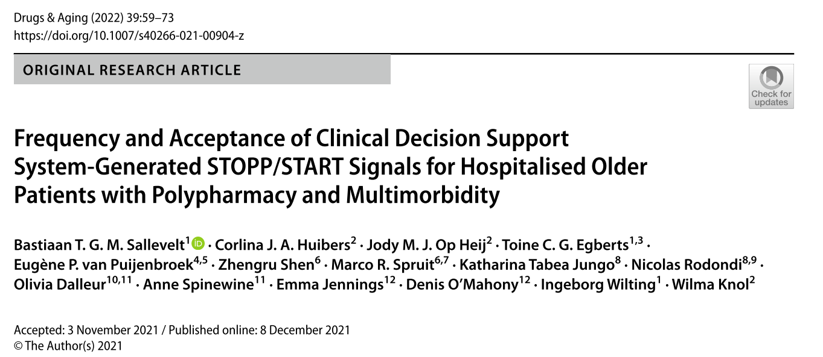

Slide 37
Sallevelt et al Drugs & Aging 2022
39% of the 5080 signals were accepted by the pharmacotherapy team
The signal to stop a drug without a clinical indication was most frequently generated (28%), with more than half of the signals accepted (54%)
STOPP : Benzodiazepines for ≥4 weeks
181 (64.1%) of acceptance

Slide 38
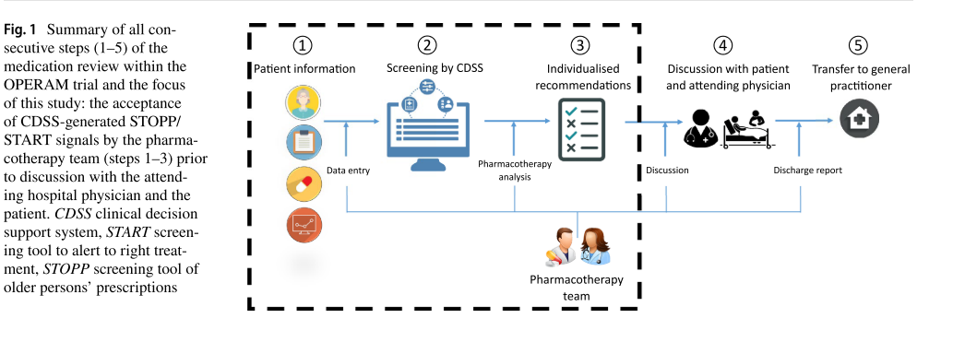

Slide 39
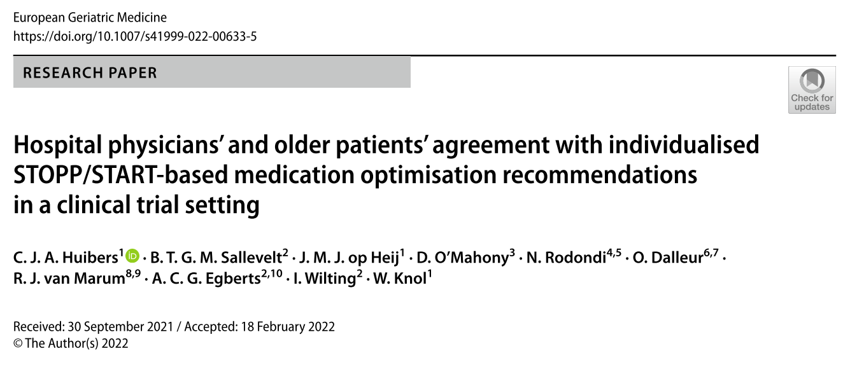

Slide 40
Huibers et al EGM 2022
Data from the Dutch intervention arm
139 participants, 371 recommendations
overall agreement with patients and physicians, was 61.6% for STOPP and 60.7% for START recommendations.
main reason for disagreement (40%) was patients’ reluctance to discontinue or initiate medication

Slide 41
Huibers et al EGM 2022
Within the psychotropic medication group, 49 recommendations involved stopping benzodiazepines or Z-drugs. 55.1% were agreed upon by both patient and physician.
Disagreement, when it occurred, was in the great majority (90.9%) due to reluctance to discontinue by the patient. The most common reasons given were chronic use without side effects (falls or sleepiness) and self-reported dependence by patients.

