Slide 1
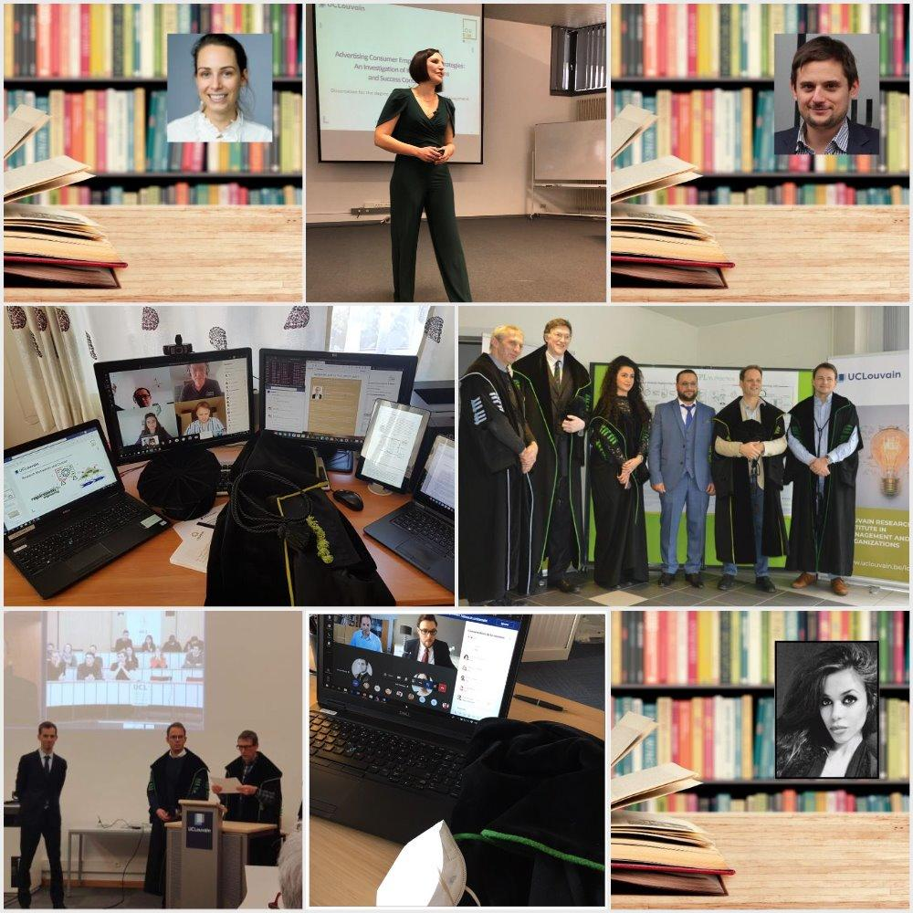
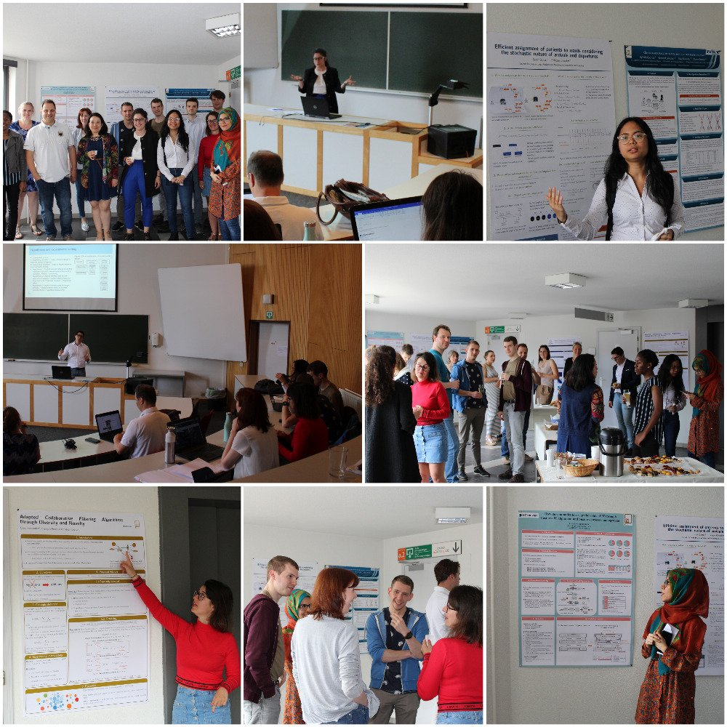
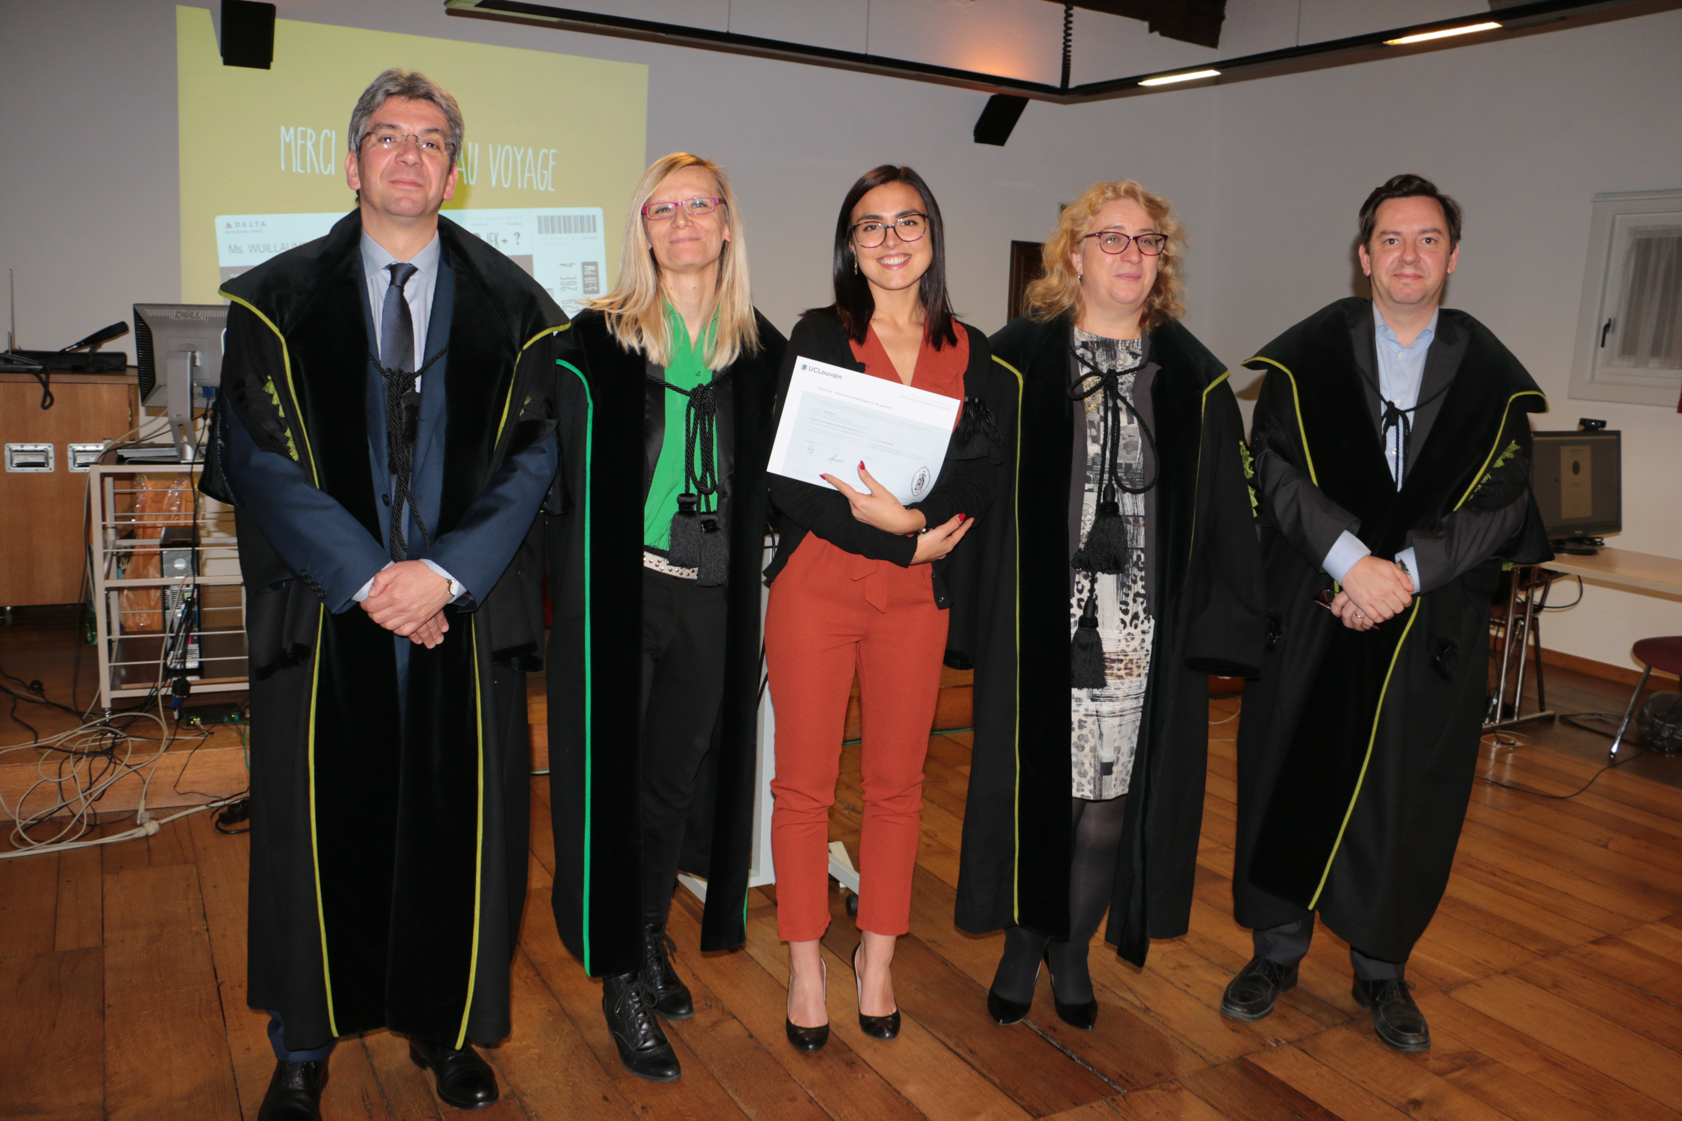
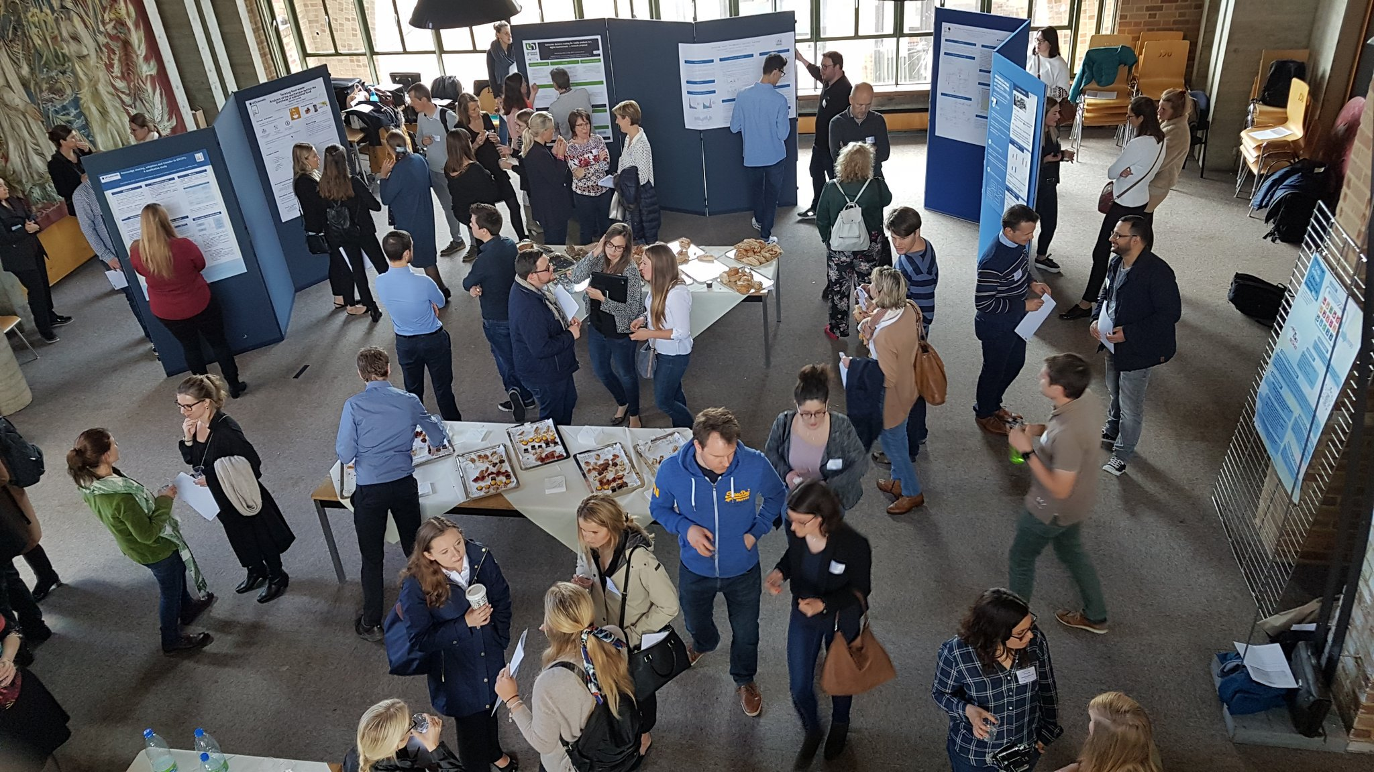
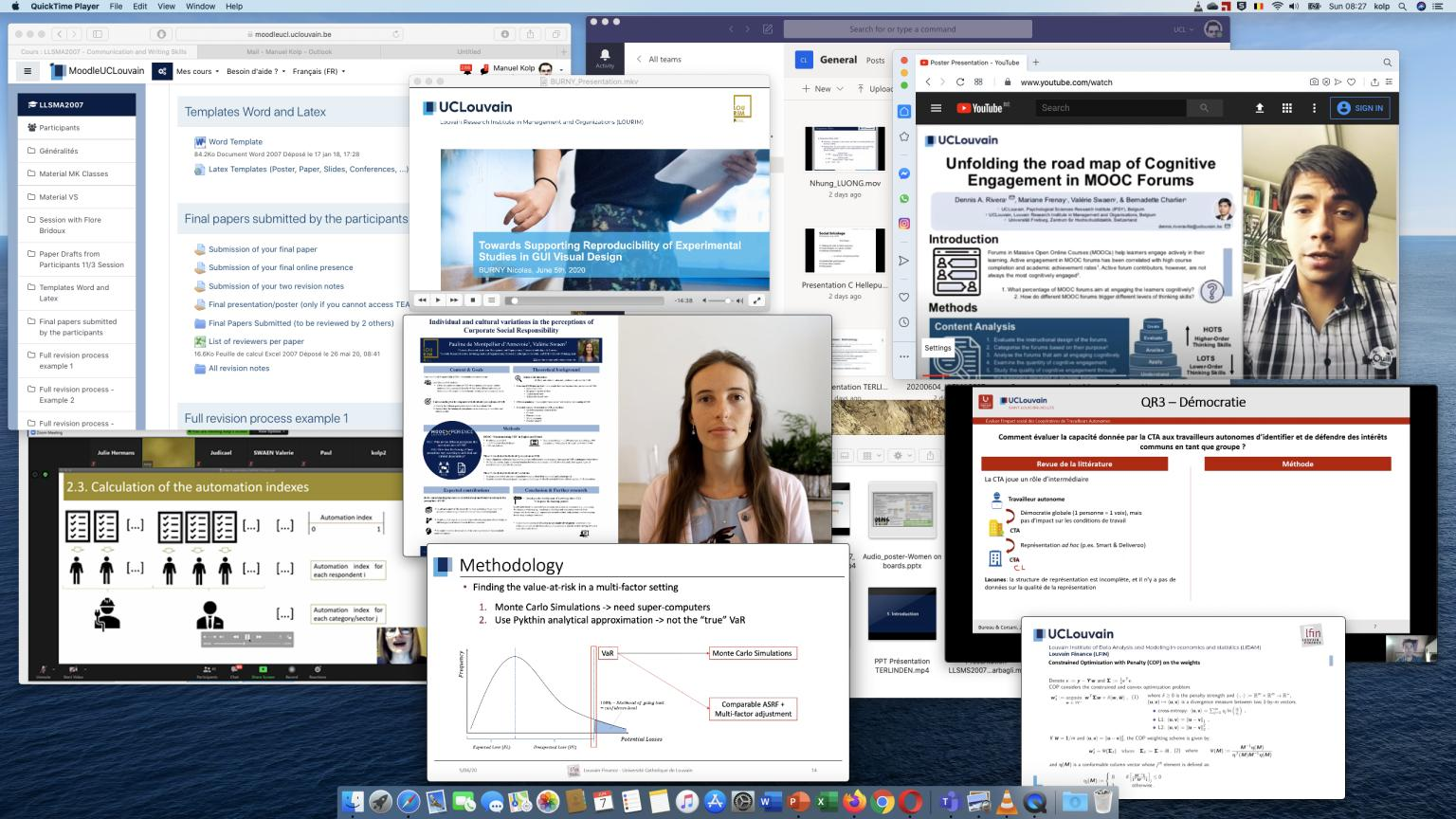
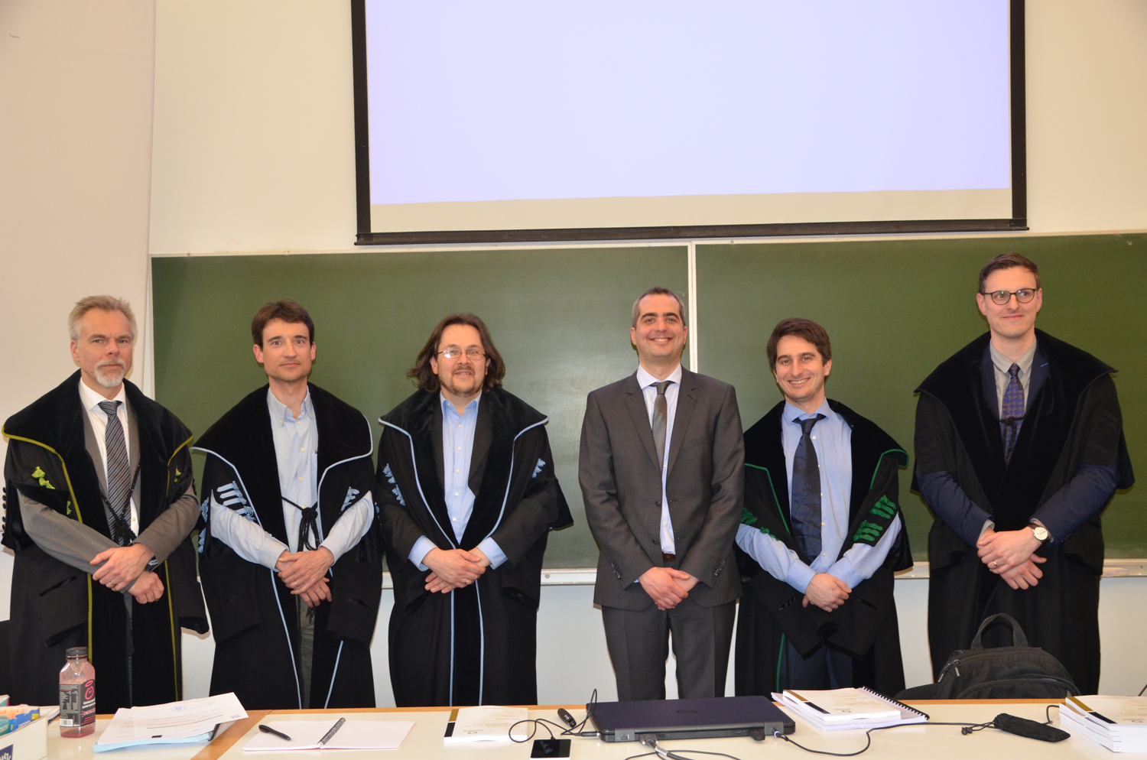
Doctoral School of Management PhD Program @ LSM
CDD Economics and Management (CDE)
Bureau Gestion
Pr. Ingrid PONCIN

Slide 4
DSM: “Joint EDT” UNamur – UCLouvain see Doctoral School of management
CODOL
CDD - CDE
EDT
Doctoral School of Management
EDT
Doctoral School in Management Sciences
Doctoral training
Ecoles Doctorales Thématiques

Slide 5
Doctoral Commission vs Doctoral School
Doctoral Commission CDE
Determines rules for doctoral studies and degree
Validate stages of students’ doctoral training
Handles admission and pre-admission to the program
EDT Doctoral School of Management - Content
Organizes doctoral courses and events
Finances activities e.g. PhD Day (when funding available)

Slide 6
CDD Econ Management
Pr. Ingrid PONCIN, vice-Chair
Pr. Amélie JACQUEMIN
Pr. Frédéric VRINS
Pr. Wim LAURIER
Pr. Rigas OIKONOMOU (Chair)
Pr. Vincent BODART
Pr. Johannes JOHNEN
Pr. Gilles GRANDJEAN
Antoine GERMAIN, PST
Invited members:
Jennifer Van den Abbeele, SAFI
Isabelle PORTZENHEIM, ESL
Sarah AUSPERT, USL-B
Bureau Gestion

Slide 7
Regulations
Decree “Paysage et organisation des études ” (07/11/2013)
UCLouvain doctoral regulation (29/03/2018)
Specific dispositions CDD Econ & Management - CDE (05/12/2017)
Vademecum 2023-2024
Registration at UCLouvain (registration office) :
To do immediatly after admission by CDE
Online registration : https://uclouvain.be/fr/etudier/inscriptions/futurs-etudiants.html (english version available)
Contacts LLN inscription-lln@uclouvain.be & Mons inscription_mons@uclouvain.be
Registration fees free for scientific staff members, UCLouvain fellowship & researchers : https://uclouvain.be/en/study/inscriptions/financial-assistance.html
Yearly registration process until the defense

Slide 8
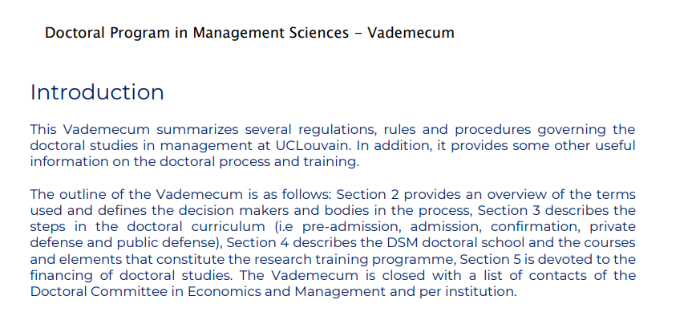

Slide 9
Typical Doctoral process
CDD - CDE
Admission
Confirmation
Private defense
Public defense
Pre-admission
≤ 1 yr
≤ 2 yrs
≥ 1 yr
≤ 3 mth
Temp supervisor
Supervisor
Supervisory panel
Doctoral jury

Slide 11
Your Doctoral training at UCLouvain - LSM
Core courses, 3 x 5 = 15 ECTS
In Admission application
Doctoral courses ≥ 8 ECTS
Doctoral seminars ≥ 4 ECTS
30 ECTS
Confirmation 5 ECTS
Scientific communication and publication ≥ 13 ECTS
Academic service and outreach ≤ 12 ECTS
30 ECTS
Thesis work, 120 ECTS
including private and public defenses
120 ECTS

Slide 12
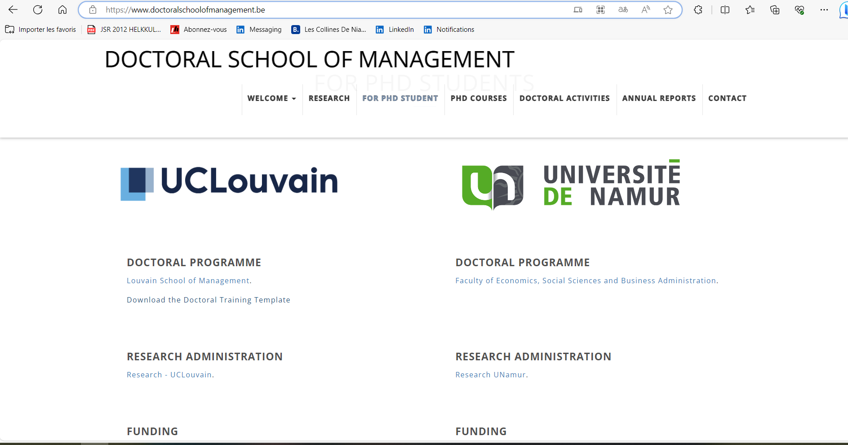

Slide 13
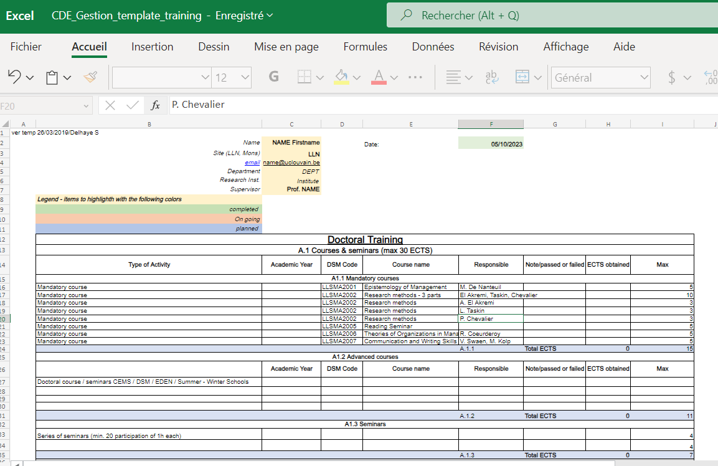

Slide 14
Courses and seminars
 | Doctoral school of Management | ECTS
Core courses [Automatic credit if Master FA = 15 ECTS]
 | LLSMA2001 Epistemology of Management (5) LLSMA2002 Research Methods (10) Qualitative Research Methods (3) Quantitative Research Methods (3) Advanced and Discrete Optimization (3) LLSMA2006 Theories of Organizations in Management (5) LLSMA2007 Communication and Writing Skills (5) | 15
Advanced courses |  | ≥ 8
Doctoral courses | Internal or external (not Master’s) | *
Summer schools | Course lectures, presence, individual assessment, at least 30h, topic relevant for thesis
Seminars and reading groups |  | ≥ 4
Doctoral seminars | Reading seminars, individual presence, 20 h, topics imposed, individual assessment (pres/report)
TOTAL |  | 30

Slide 16
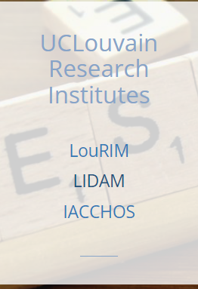
Research Entities: “Content Contributors”

Slide 17
Pubs & Conference presentations
 |  | ECTS | limit
Publications
 | Paper, single author, journal rank JUFO 2 or 3 | 6
 | Paper, co-author, journal rank 2 or 3 | 5
 | Paper, single author, journal rank 1 | 4
 | Paper, co-author, journal rank 1 | 3
 | Book chapter in refereed edited volume | 2
 | Working Paper, (series approved by the CDD) | 2 | ≤ 6
Communication at Scientific Conferences
 | Paper, accepted international conference with reviewing | 3
 | Paper, accepted national conference with reviewing | 1
 | Poster, accepted, conference with reviewing | 1

Slide 18
Invitations and active participations
 |  | ECTS | ECTS
Invited talks and keynote addresses
 | Invited lecture or keynote (open seminar or conference) in an recognized institution (CDD approval) | 3
 | Invited research visit (min 3 month) in an international research institution (CDD approval) | 6
Scientific events
 | Doctoral forum or workshop (individual presentation, per doctoral school) | 1 | ≥ 3
 | Open research seminars (min 10 h par year, research, attendance), | 2 | ≥ 4 ≤ 8
 | Writing seminars/courses | 1
TOTAL |  | ≥ 13

Slide 19
Services to School and Research
 |  | ECTS | max
Teaching
 | Teaching (min 60 h, min 2 different courses) | 3 | 3
 | Supervision master’s thesis (co-promotion) | 1 | 3
International cooperation
 | International cooperation (stay, teaching min 10 h in developing country through recognized organization) | 3 | 3
Refereeing
 | Editing of referee report (journal in JUFO), by direct invitation by Editor, per report | 2 | ≤ 6

Slide 20
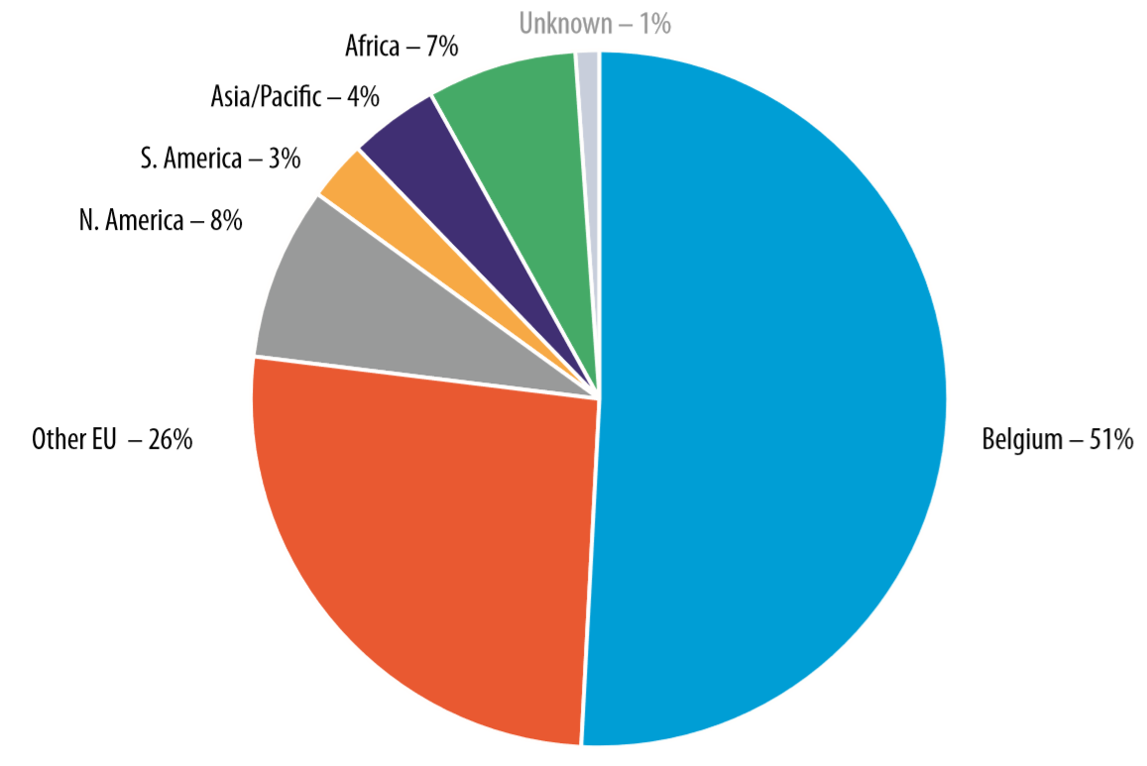
Some (rough) Figures 2017 - 2019
> 200 doctoral activities organized
35 PhD defended
> 70 PhD students / year
> 50% international PhD students
Placement
60% academia
25% in academic positions
25% PostDoc
30% invited lecturers
50% corporate, international institutions, public, start-up, ... companies
Location after Phd 10 years

Slide 21
Examples of Recent Placements
Project Officer, European Commission, …
PostDoc, HEC Montréal, ULiège, ULB, …
Assistant Professor EDHEC, IESEG, HEC Liège, Toulouse BS, Solvay, UNamur, ICHEC, NEOMA BS, …
Project Manager Positions in Higher Education Institutions
Founder SME
Economic Advisor, Banque Centrale du Luxembourg, OCDE, BNB, …
Invited Lecturer/Adj. Prof./Scientific collaborator UCLouvain, ULB, UNamur, ULille, ULiège, …

Slide 24
Contacts & Info
Coordination du Doctorat UCLouvain
Administration de la Recherche - ADRE
sophie.leclere@uclouvain.be (Sophie Leclère) 010 47 92 33

